Slide 1
IBM Data Science Capstone -
Battle of Neighborhoods
Finding Viable Food Waste Management Center Locations
By: Eugene Bible
February, 2020

Slide 2
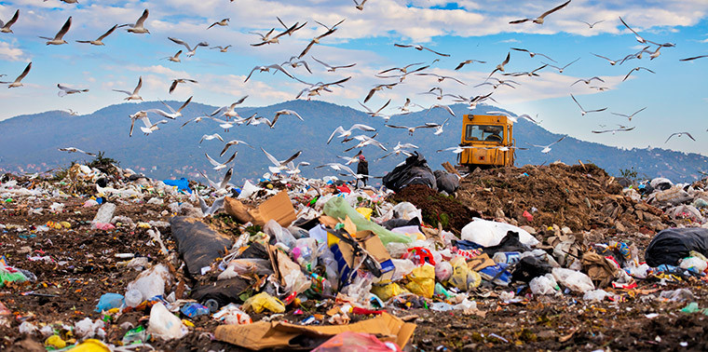
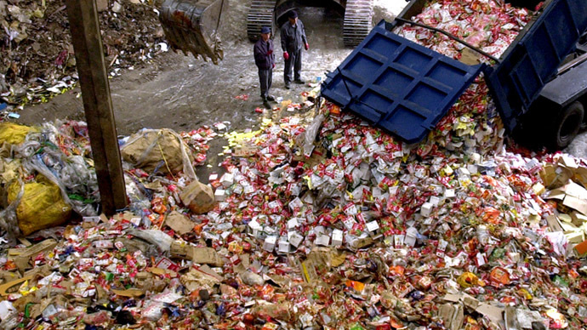
Introduction
The Problem - Food Waste in the U.S.
In the United States, food waste is estimated to be between 30–40 percent of the food supply.
This loss is due to inefficiency at almost every level of the food retail and production chain and results in massive losses of money, energy, water, and labor, as well as the food that could be used to feed the hungry.

Slide 3
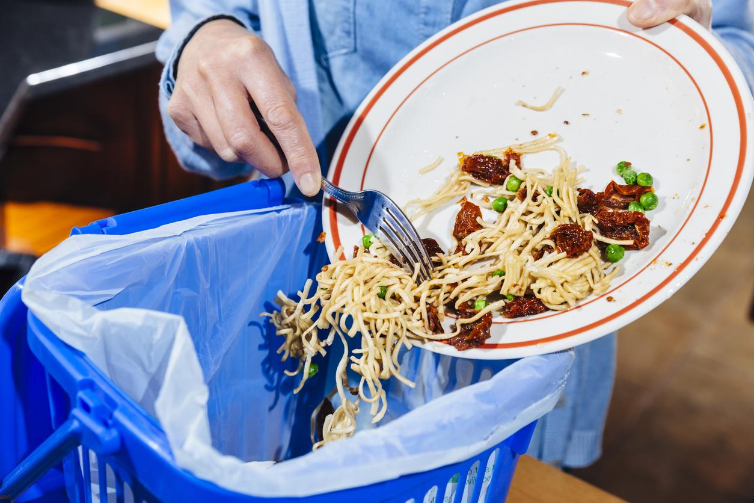
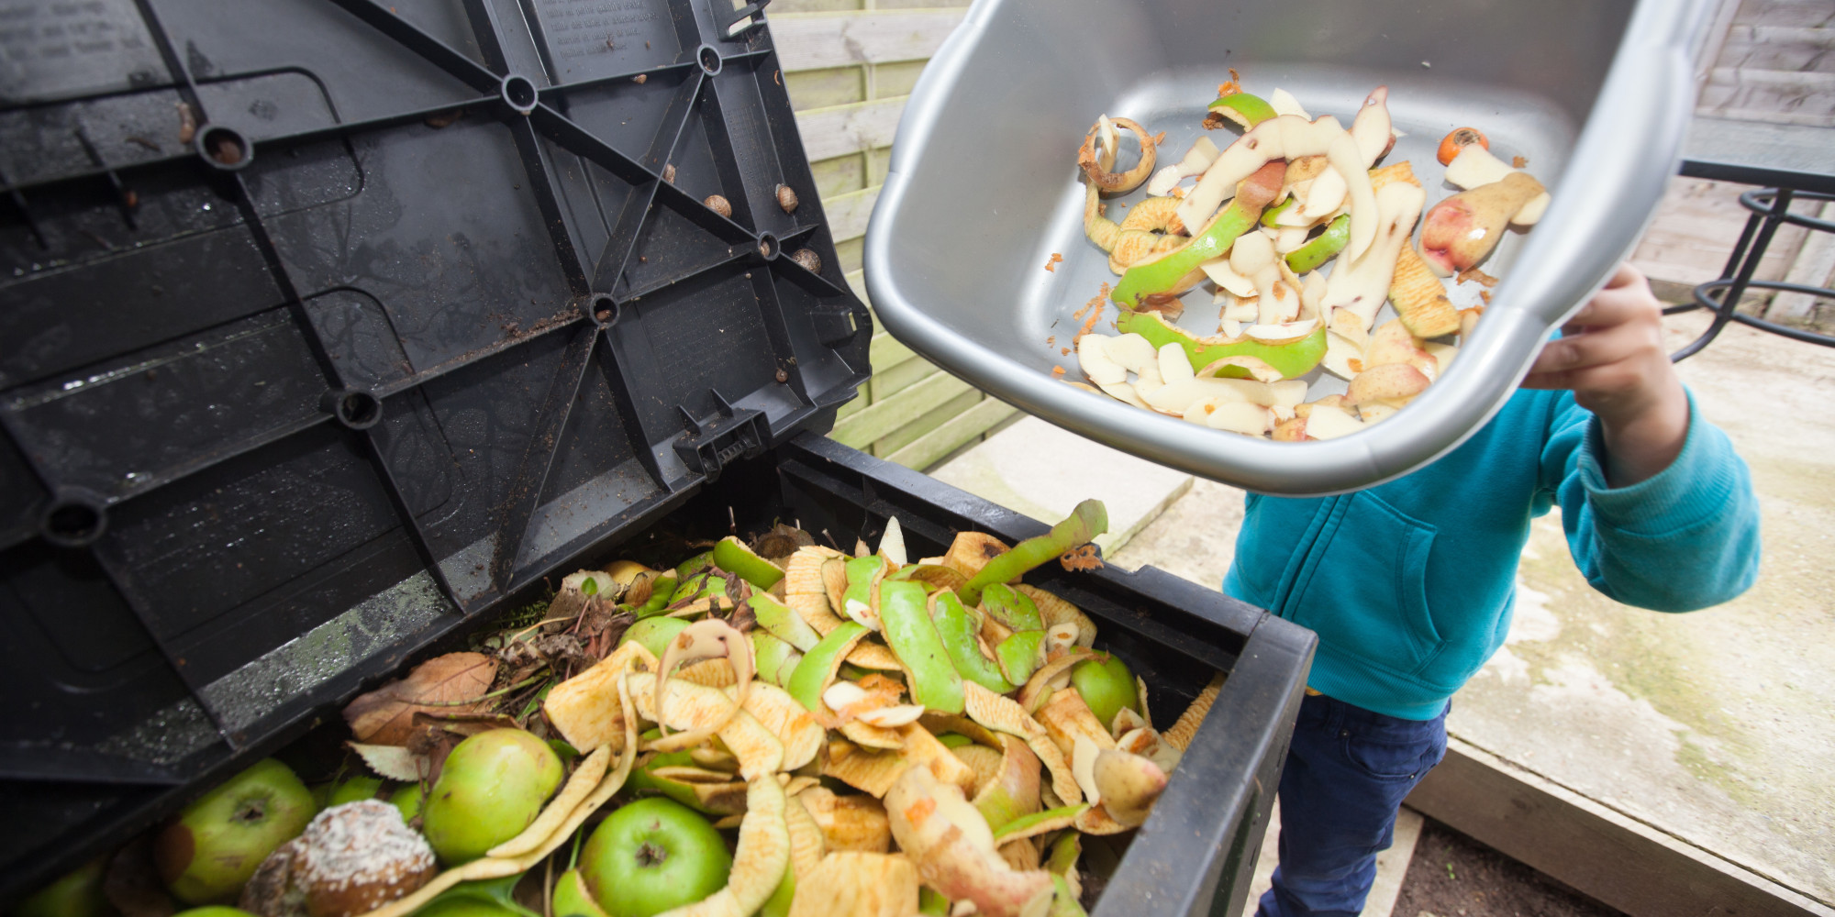
Introduction
The Problem - Food Waste in the U.S.
In 2010 alone, based on the USDA’s Economic Research Service, 31 percent food loss occured at the retail and consumer levels, corresponding to approximately 133 billion pounds and $161 billion worth of food. (1)

Slide 4
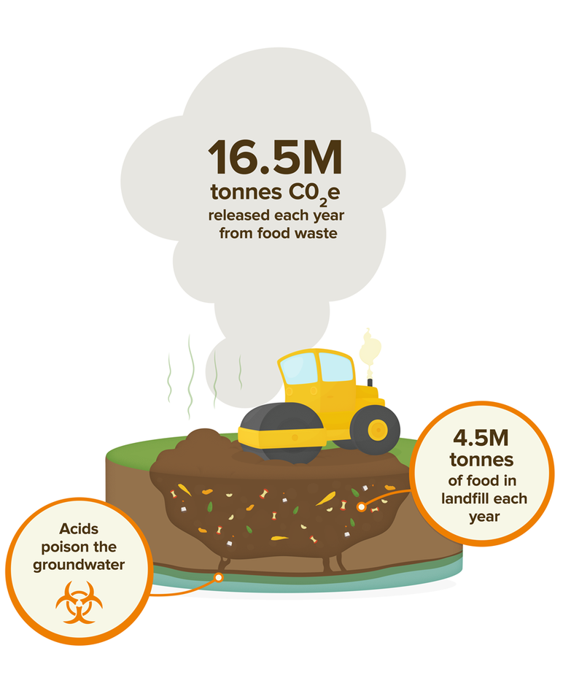
Introduction
The Result?
This wasted food is the largest category of material placed in landfills (2) and the rotting food waste contributes a large part to global greenhouse gas emissions resulting in global warming and climate change.

Slide 5

Introduction
What can we do?
By more efficiently managing our food supply chains and wasted foods, we can save money, water, and energy, mitigate climate change, and reduce our impact on the environment, all while feeding more people, reducing poverty, and improving impoverished communities.

Slide 6


Let’s Talk Food Waste
“Food losses” are inefficiencies that occur before the food reaches the consumer (issues in the production, storage, processing, distribution, etc.) whereas “food waste” refers to food that is fit for consumption but consciously discarded at the retail or consumption phases. (3) This report will focus primarily on food waste.
Sources of Food Waste: - Residential (Homes, apartments, dwellings): Primarily rotten food and kitchen scraps
- Restaurant-based (Restaurants, cafes): Primarily rotten food and kitchen scraps
- Retail-based (Supermarkets, convenience stores): Primarily foods that are still viable for consumption, but near expiration date (which are mostly artibrarily set)

Slide 7
Food Waste Solutions
Commonly Employed Solutions of Food Waste: - Composting to create fertilizer (On-site and/or mass composting via composting centers)
- Anaerobic digestion, which uses microorganisms to break down biodegradable material as opposed to dumping in landfills
- Using the food waste to create animal feed
- Recycling the food waste to use in creation of bio-fuels
- Selling still-viable food (fruits, vegetables, canned goods) to lower income people at a heavily discounted price or giving it away to homeless
- Selling cooked/prepared food made from no-cost, still-viable food waste at low-cost

Slide 8
The All-In-One Solution:
Food Waste Management Centers

Slide 9
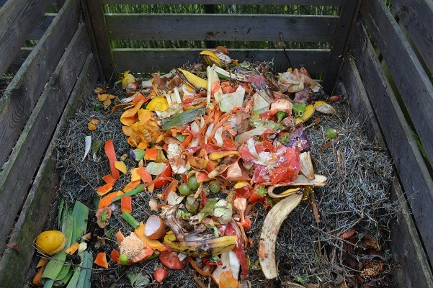
At present, the US is not doing nearly enough to manage food waste.
The optimal solution would be for individuals and companies to self-regulate their own waste, but this is a slow process that requires education and a cultural shift to more conscientious waste management practices.
Tip
Don’t wait till the end of the presentation to give the bottom line.
Revea your product or idea (in this case a translation app) up front.

Slide 10
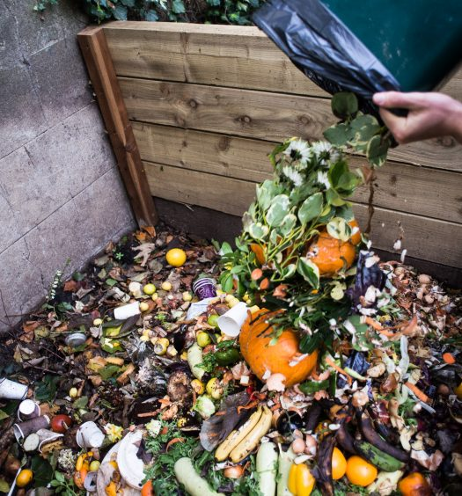
Rather than trying to educate every individual and immediately enact change across business, if we were able to centralize the food waste, a few experts and specialists could manage the various types of food waste much more effectively and efficiently.
Food Waste Management Centers could be placed throughout our most populated cities in the areas where the most food waste is created.

Slide 11
Let’s Talk Food Waste
“Food losses” are inefficiencies that occur before the food reaches the consumer (issues in the production, storage, processing, distribution, etc.) whereas “food waste” refers to food that is fit for consumption but consciously discarded at the retail or consumption phases. (3) This report will focus primarily on food waste.
Sources of Food Waste: Highlight what’s new, unusual, or surprising.
Emotional Give people a reason to care.
Simple Provide a simple unifying message for what is to come

Slide 12
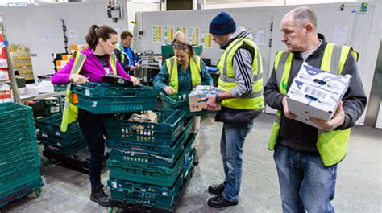
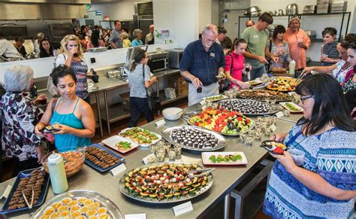
FWMC Within the Community
These centers can become integral parts of the community: supporting the lower income people and homeless with discount food, reducing food waste volume which will maintain a cleaner neighborhood, educating the community in reducing food waste, and reducing the waste disposal costs to businesses.

Slide 13
Analysis to be Performed: Selecting Food Waste Management Center (FWMC) Locations

Slide 14
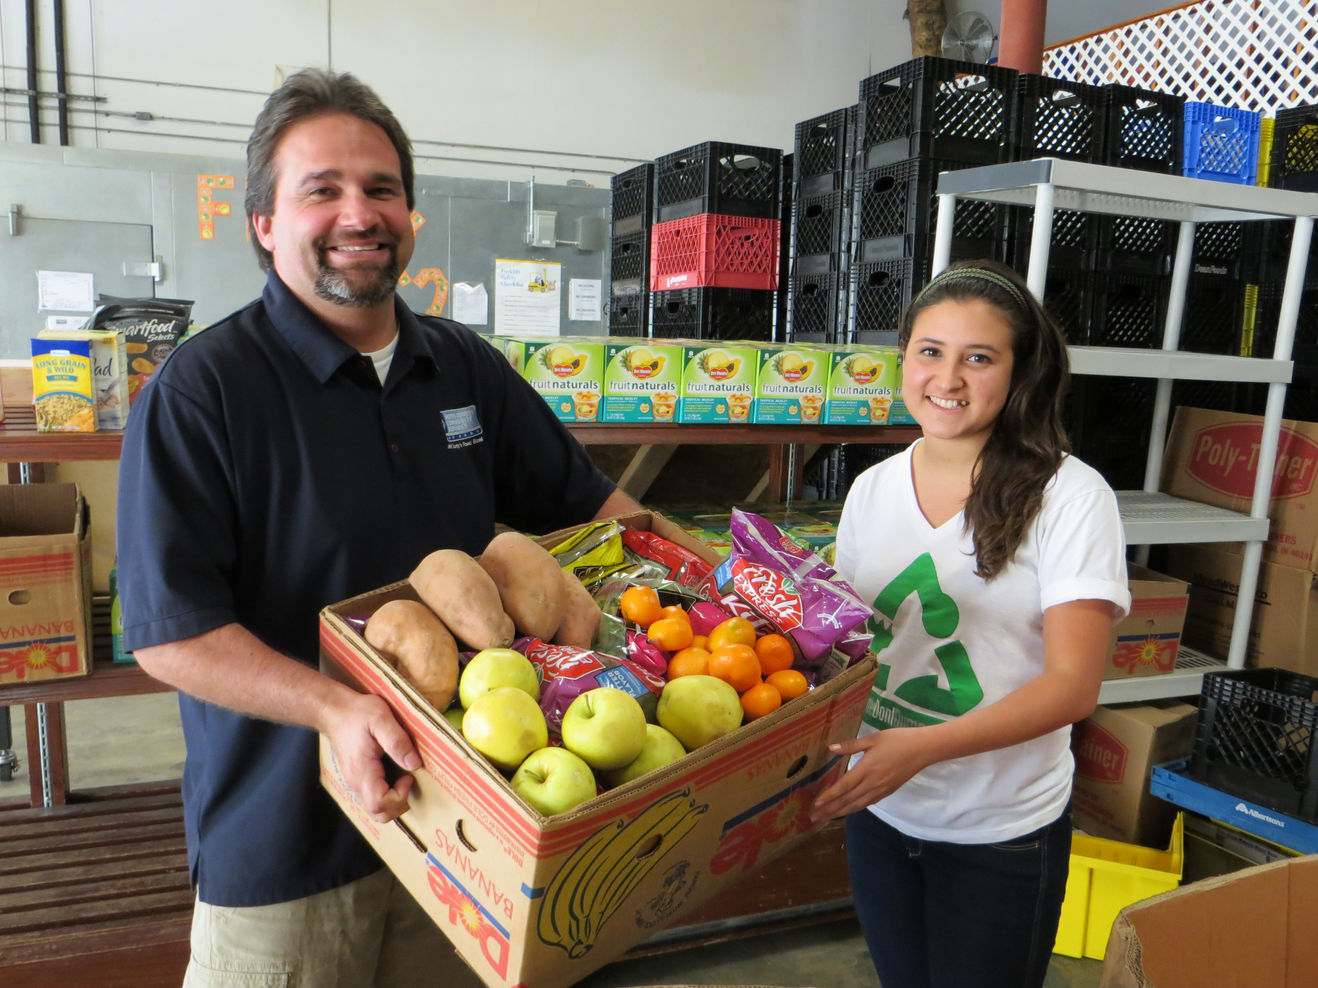
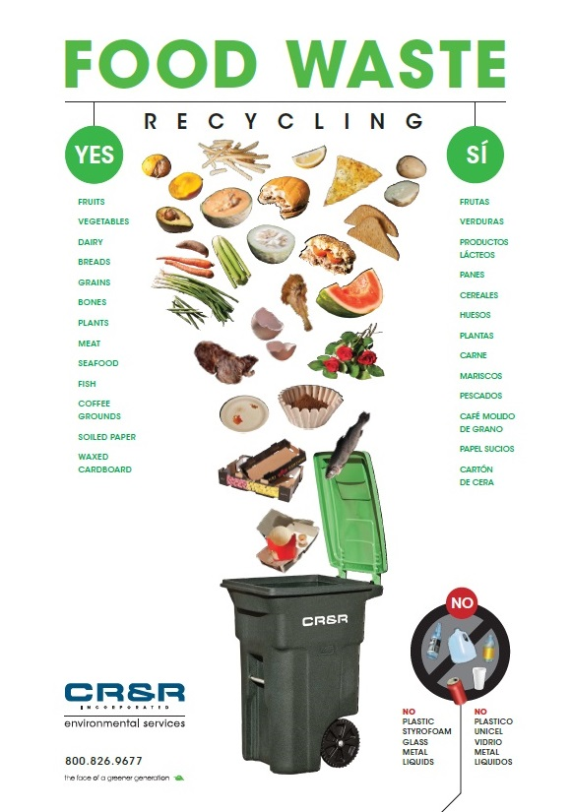
FWMC Functions
Let’s assume our FWMC will...
Receive shipments of food waste from all nearby restaurants, supermarkets, residents, and food-service businesses.
Sell viable fresh food such as fruits and vegetables at a discount.
Sell lunch boxes made from recovered food at low-cost.
Package the rotting/unusable food scraps for shipping to a composting center or biofuel production facility.
Work with and educate the community on food waste reduction

Slide 15
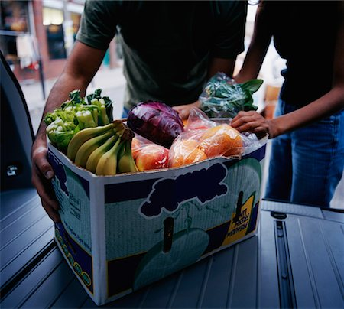
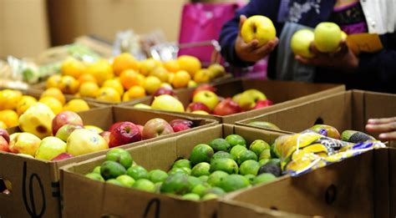
FWMC Functions
What kind of location is optimal?
A FWMC needs to be placed in a location optimized to:
Receive shipments from each restaurant and business in the area.
Sell discounted food (both prepared and fresh) to the community.
Be convenient to easily drop off food waste.
Work well with the community.
It needs to be placed in a central location where people and restaurants are!
In short...

Slide 16
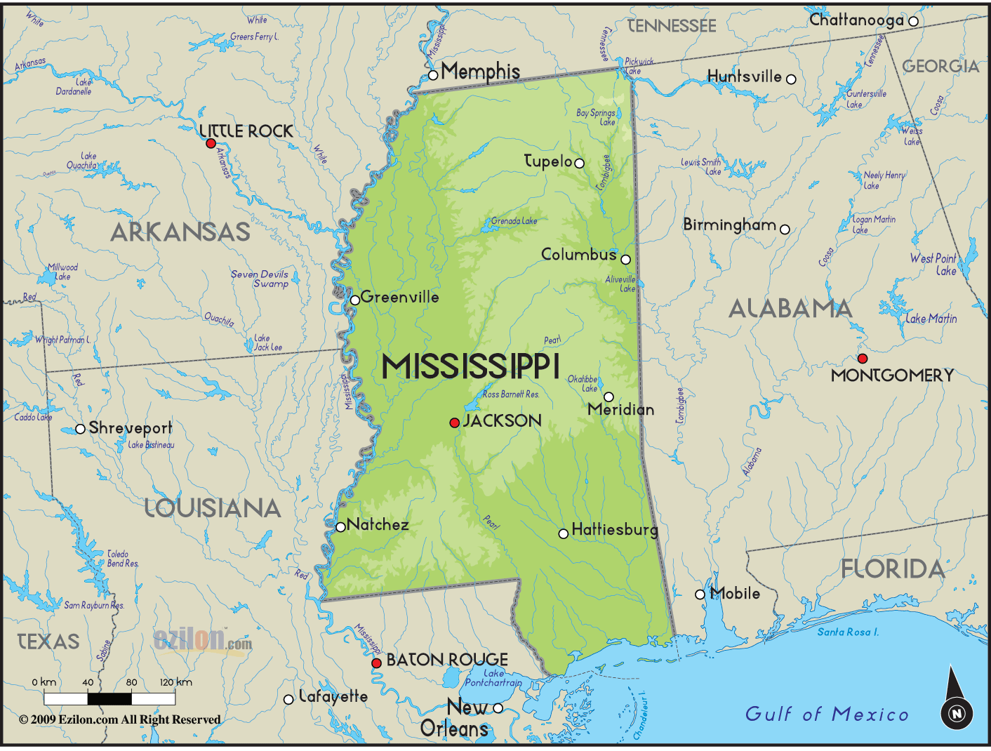
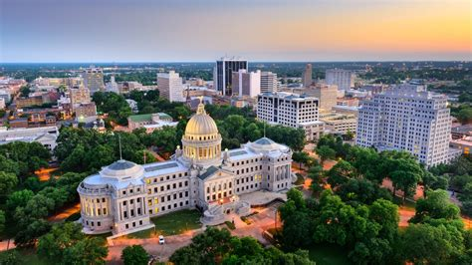
In this analysis, I plan to determine optimal locations for a Food Waste Management Center (FWMC) within the city of Jackson, Mississippi.

Slide 17
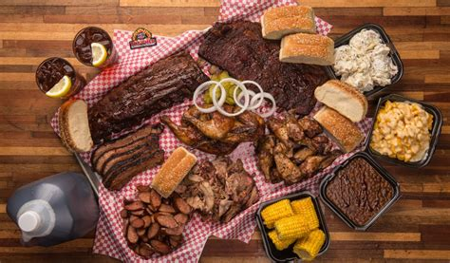
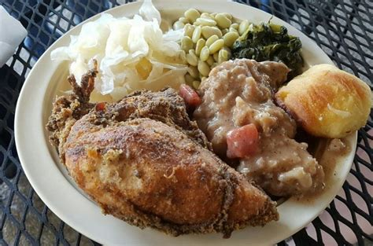

Why Jackson, Mississippi??
The state of Mississippi is a state with the highest rate of wasted food.
Based on a study performed by Hloom, the people of Mississippi on average throw away 14% of their food at home and 11.6% of restaurant meals. (4)

Slide 18
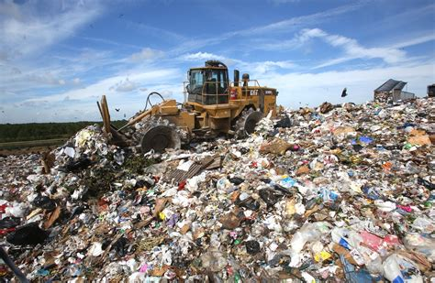
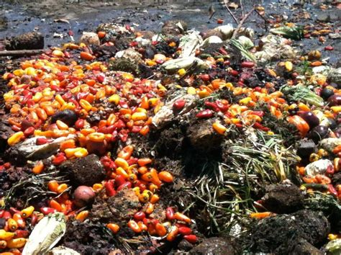
Why Jackson, Mississippi??
It is also one of the only states that has almost no composting, food bank, or anaerobic digestion facilities to reduce food waste, meaning that nearly 100% of the food waste is dumped in a landfill: the worst-case scenario for handling food waste.
This makes Jackson, Mississippi a prime target for the development of food waste management.

Slide 19
Who cares?
The target audience for this project is any government entity like the Environmental Protection Agency, the U.S. Department of Agriculture, or any business entrepreneur that may be looking to capitalize on food waste as an untapped resource.
Potential Benefits of a FWMC:
Both state and local government entities can incorporate food waste prevention and education campaigns as part of a city-wide community development effort.
Having a centralized Food Waste Management Center means easier management and collection of waste data.
Cost reductions across the entire spectrum of waste management (garbage collection decreases, less landfill space used, etc)
Potential profitability in sales of composted fertilizer.
Potential profitability in sales of food made from donated no-cost ingredients.
Potential profitability in sales to facilities producing biofuels.

Slide 20
Data Sources
Required Data and Data Sources
EPA Estimated Food from Residential and Commercial Sources: U.S. Waste data.
We will briefly examine the trends of food waste in the United States and how much is managed, used for power generation, recycled, composted, etc.

Slide 21
Data Sources
Required Data and Data Sources
Foursquare API: Supermarket, restaurant, food-service data
In order to properly perform this analysis, we need to locate the high food waste production areas of Jackson, Mississippi. This can be done using the FourSquare API to find high-density areas of restaurants, cafes, and supermarkets.
We will assume for our analysis that areas with high densities of restaurants, cafes, and supermarkets are also commonly residential areas.

Slide 22
Methodology
First, we will do a brief analysis of current food waste management and how much the U.S. wastes and examine how much more there is still to be done. We will scrape the necessary data from the web using the JSON and BeautifulSoup Python packages. The data will be stored in a Pandas dataframe and visualized using Folium and Matplotlib.
Next, we will make the necessary requests for venue information from the Foursquare API. The data will be cleaned, stored, and sorted. We will need to group the venues into groups based on location (in our case, neighborhoods). Again, we will visualize the data using Folium.
1
2

Slide 23
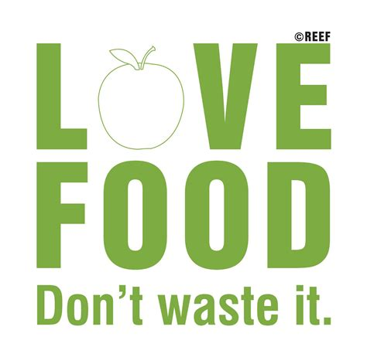
Methodology
Next, we will use the K-Means clustering algorithm to cluster the neighborhoods to determine which are the high-density food waste producer neighborhoods.
Based on our K-Means clustering analysis, we will examine and determine the best neighborhood for a Food Waste Management Center.
3
4

Slide 24
This Project Around the Web
This project can be found around the web at the following links:
IBM Watson Studio: https://jp-tok.dataplatform.cloud.ibm.com/analytics/notebooks/v2/cc31f32a-f0ad-43e4-a474-79f89ad0d697?projectid=0e052036-fd3e-4893-a04b-46349d1af3d9&context=analytics
Github: https://github.com/Glitch852/Coursera_Capstone/blob/master/IBM%20Data%20Science%20Capstone%20-%20Final.ipynb

Slide 25
References
U.S. Food and Drug Administration, "Food Waste and Loss", https://www.fda.gov/food/consumers/food-waste-and-loss
Jean C. Buzby, Hodan F. Wells, and Jeffrey Hyman (United States Department of Agriculture), "The Estimated Amount, Value, and Calories of Postharvest Food Losses at the Retail and Consumer Levels in the United States", https://www.ers.usda.gov/webdocs/publications/43833/43680_eib121.pdf
Harvard T.H. Chan School of Public Health, "Food Waste: The Big Picture", https://www.hsph.harvard.edu/nutritionsource/sustainability/food-waste/
Eleanor Goldberg, "These States Waste The Most Groceries And Restaurant Meals", https://www.huffpost.com/entry/these-states-waste-the-most-groceries_n_57b1f085e4b007c36e4f7168

Slide 26

Thank you for reading my report!
-Eugene

